Slide 1
From ugly duckling to white SWAN (Contribution: rewriting phase)
Семинар 6 Мастерская публикаций 24.09.2013
A.Porshnev
NRU HSE, N.Novgorod

Slide 2
Polishing phase
“All good papers was bad papers enough revised” Marc Raibert
Easy to see what you want to see
Hard to evaluate your own work
Need for good reviews
or artificial tools

Slide 3
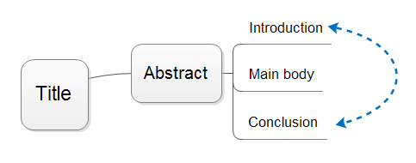
Structure of an article
Title
Abstract
Introduction
Main body
Conclusion

Slide 4
Title
Impact of your research
Main application of your research
Used methodology to determine the results of your research
Results (our section) corresponding to the contribution of your research
Ex1. What Clients Don't Get About My Profession: A Model of Perceived Role-Based Image Discrepancies
Ex2. Experimental Study of Inequality and Unpredictability in an Artificial Cultural Market

Slide 5
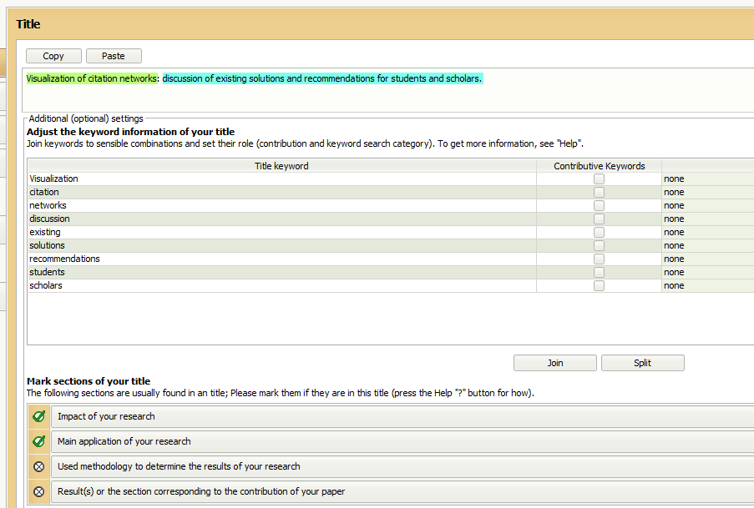
Application of the SWAN

Slide 6
Results for title evaluation:
(+) Your title is clear.
(+) Your title is answering the following question(s) a reader has when looking for a paper:
the What For (Visualization of citation networks); standing for the application of your paper.
the So What (discussion of existing solutions and recommendations for students and scholars.); standing for the impact of your paper.
(?) Title attractiveness is low. [hide]
It lacks words such as adjectives, adverbs, or numbers, or non search keywords that are attractive for the simple reason that they belong to another field or domain.
(?) With 0 search keywords, your title is difficult to find. You should have search keywords in your title.
(?) You have chosen not to answer the following question(s):
the What, standing for the contribution of your paper.
the How, standing for the methodology used in your paper.
[more] (!) You title has two parts separated by either a ' : ' (colon) or a - (dash). In this situation, make sure that the part of the title before the punctuation is kept short. Such titles have two places of emphasis, while traditional titles have one (upfront in the verbless title). These places are 1) the first few words at the head of the title, and right after the dividing punctuation, as in "Web Services : Enabling technology for virtual communities of trading partners".
Evaluated title:
No highlightings were needed to do to this section.

Slide 7
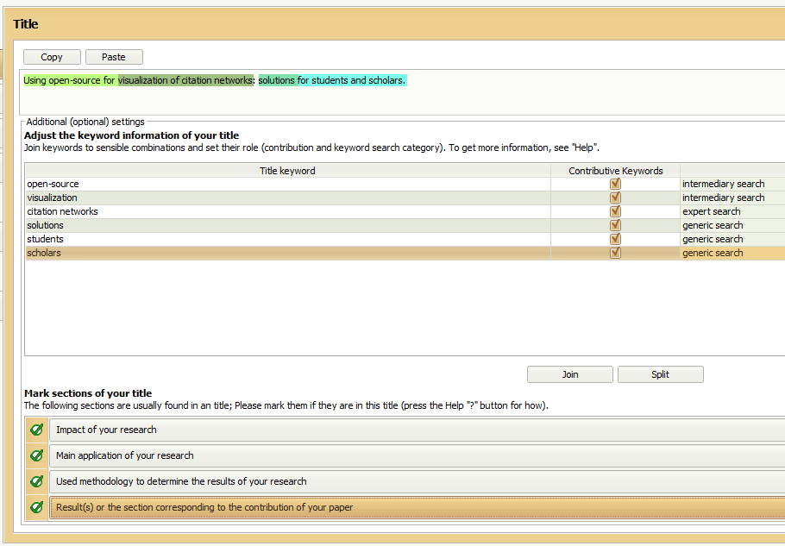

Slide 8
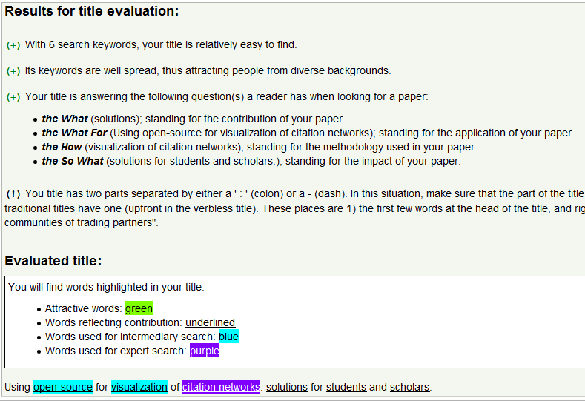

Slide 9
Abstract
Background to the contribution of your paper
Main objective of your research
Used methodology to determine the results of your research
Results (our section) corresponding to the contribution of your research
Impact of your research

Slide 10
Example
«Corporate reputation has become one of the most important intangible assets for maintaining and enhancing firms’ competitiveness in the global marketplace.
Researchers have shown considerable interest in measuring the corporate reputation construct, resulting in a lack of consensus on valid measurement approaches.
Against this background, we discuss commonly used reputation measures from a conceptual as well as theoretical perspective, and empirically compare them in terms of convergent validity and criterion validity.
By examining the measures’ psychometric properties, both theoretically and empirically, this study provides guidance for their reasonable application in business research and practice.» abstract from Journal of World Business 2012 (Musteen, Rhyne, and Zheng 2013)
1 . Background 2. Main objective 3. Used methodology 4. Results 5.Impact of your research

Slide 11
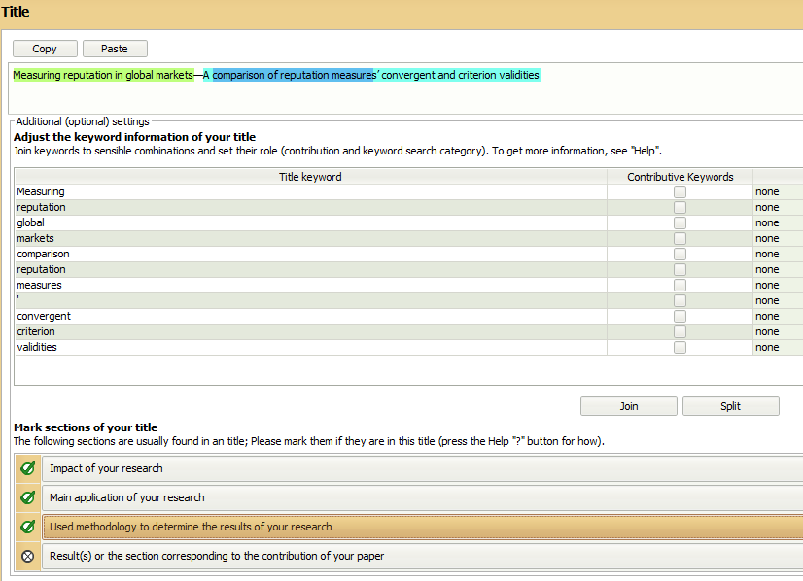

Slide 12
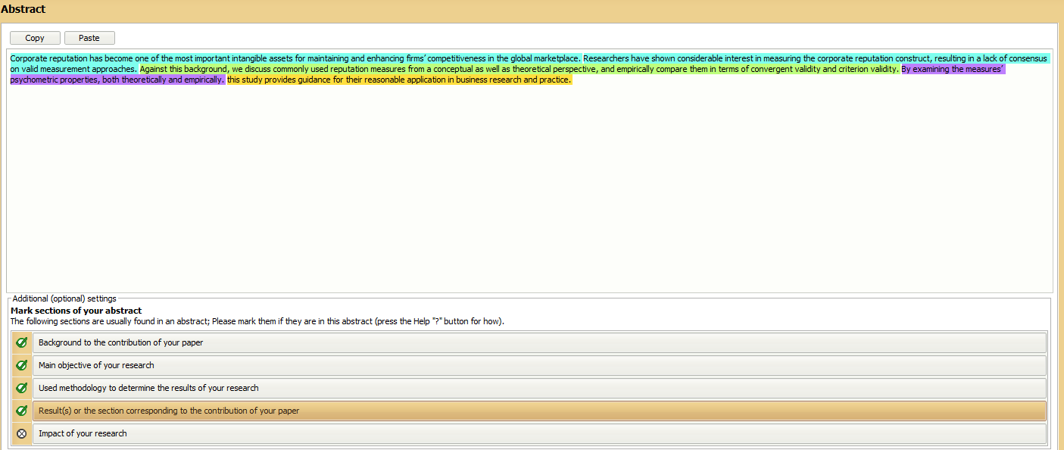

Slide 13
Results of Title evaluation
(+) Your title is clear.
(+) Title attractiveness is ensured through the use of the following words: "global", because they attract the attention of the reader.
(+) Your title is answering the main question(s) a reader has when looking for a paper:
(?) Conciseness would be increased if you removed from your title words such as "study of ...", or even articles such as "a" or "an".
(?) There also seems to be a disconnection between your title and your abstract thereby making it difficult for the non expert reader to follow you. [more]
(?) With 0 search keywords, your title is difficult to find. You should have search keywords in your title.
(?) You have chosen not to answer the following question(s):
the What, standing for the contribution of your paper.

Slide 14
Results for abstract evaluation
(+) You have made a good choice when deciding to use the present and present perfect tenses in your abstract.
(?) You have words in your title that are not used in your abstract. [more]
(?) Your abstract is incomplete. [more]
(?) It is more important to show the reader how important your contribution is in terms of impact instead of how important the problem is.
Evaluated abstract:
No highlightings were needed to do to this section.

Slide 15
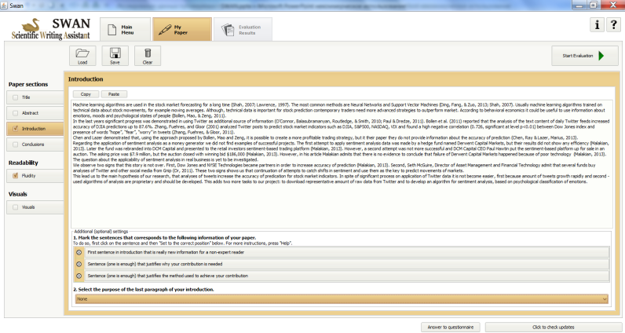
Introduction
First sentence in introduction that is really new information for a non-expert reader
Sentence (one is enough) that justifies why your contribution is needed
Sentence (one is enough) that justifies the method to achieve your contribution

Slide 16
Last paragraph of introduction
Table of contents for the rest of paper covering upcoming headings
Impact of paper
Goal of paper
Methodology of work
Main result or anticipated result of research (contribution)
Other

Slide 17
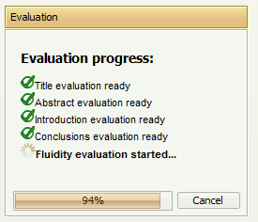
Conclusion

Slide 18
My examples

Slide 19
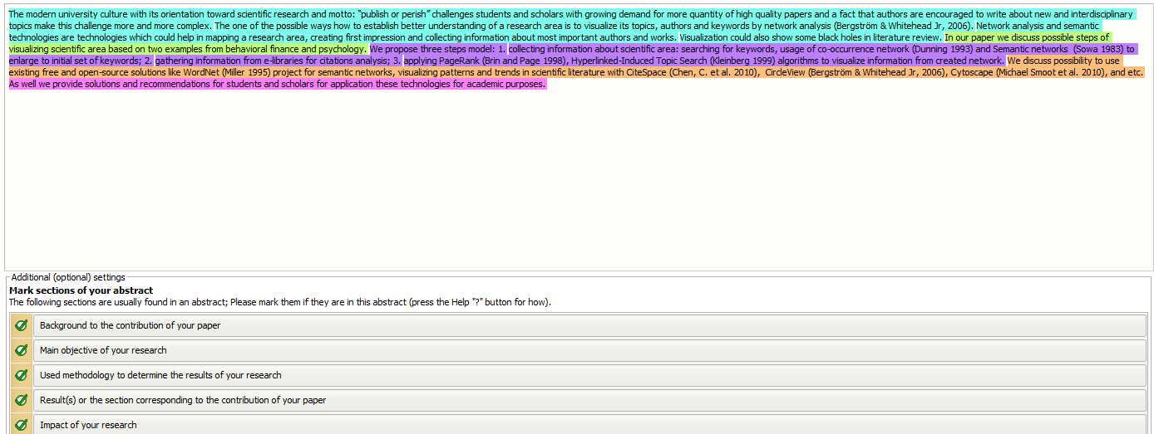
SWAN application

Slide 20
Results for abstract evaluation:
(+) You have made a good choice when deciding to use the present tense only for your abstract.
(?) You have keywords (not presented in your title) that appear at least twice in your abstract. [hide]
area
information
technologies
research
Should they also be present in your title? Do you need to rewrite your title so that it reflects better the contents of your abstract?
Evaluated abstract:
No highlightings were needed to do to this section.

Slide 21
Thank you for your attention Alexander Porshnev aporshnev@gmail.com

